Slide 1
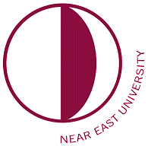
Physiotherapy&Rehabilitation
Near East University
Faculty Of Health Science
Physiotherapy and Rehabilitation Department
What is physiotherapy?
Physiotherapy is a science-based healthcare profession that promotes recovery in illness, injury or disability. It aims to restore movement and functional ability to the person’s full potential.
Physiotherapy is an independent profession where practitioners make their own treatment decisions and clinical judgements. They constantly reassess the results of their treatments and adjust their approach.
Who is physiotherapist?
Physiotherapists help people affected by injury, illness or disability through movement and exercise, manual therapy, education and advice.
They maintain health for people of all ages, helping patients to manage pain and prevent disease.
The profession helps to encourage development and facilitate recovery, enabling people to stay in work while helping them remain independent for as long as possible.
What physiotherapists do?
Physiotherapists do not just work with people after an injury, but can be found working in many fields of specialty.
Orthopedic Physiotherapists
Cardiopulmonary Physiotherapists
Geriatric Physiotherapists
Neurological Physiotherapists
Sport Physiotherapists
Pediatric Physiotherapists
Women's Health Physiotherapists
Haneen Altalbani, 4th year student

